Slide 1


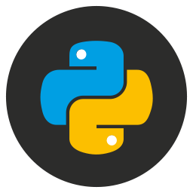
Getting Started with Python & DynamoDB
from someone who just got started...
Hunter McGuire

Slide 2

Who am I?
Engineer – I like to build stuff
PowerPoint Wizard
Not a developer
Not a DBA

Slide 3
Today's Agenda
Basic fundamentals of DynamoDB
Single-table design
Python boto3 SDK abstractions
Device-Manager app overview and demo

Slide 4
What is DynamoDB?
Fully Managed NoSQL
Wide Column Document
Scalable
Fast
Fine-Grained Access Control

Slide 5
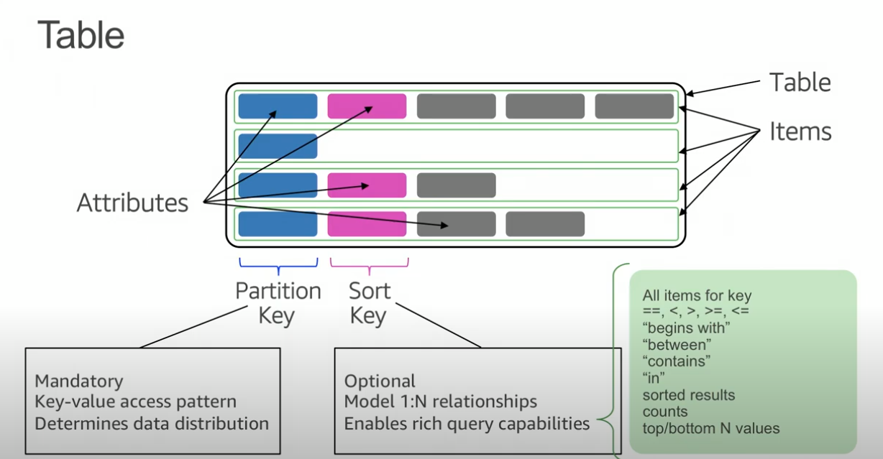
Table Components
Primary Key
Simple: Partition
Composite: Partition + Sort
Secondary Indexes
Notes:
Primary Key(Unique):
- Simple: just Partition Key
- Composite: Partition Key + Sort Key
1:N – 1 to many relationship
Of Note:
Global secondary index – An index with a partition key and sort key that can be different from those on the table.
Local secondary index – An index that has the same partition key as the table, but a different sort key.

Slide 6
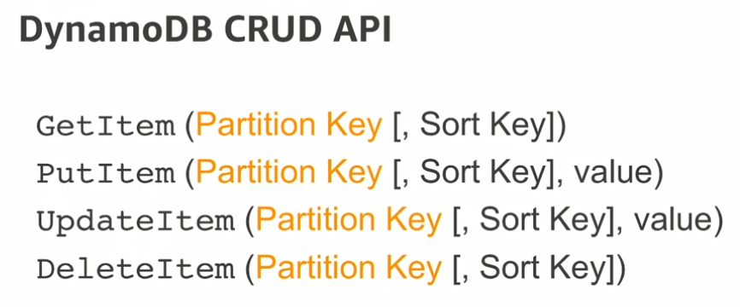

Slide 7
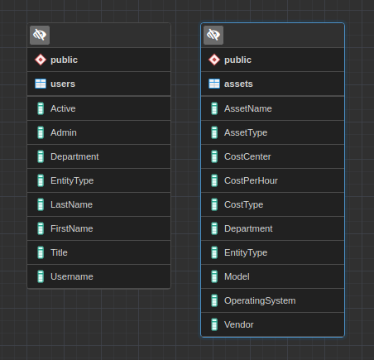
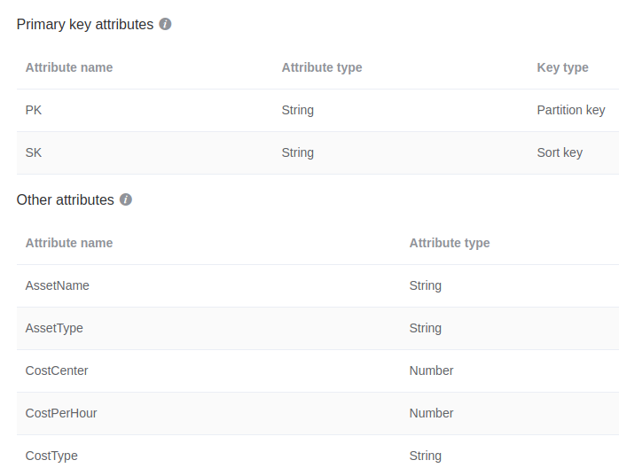
RDBMS vs NoSQL

Slide 8
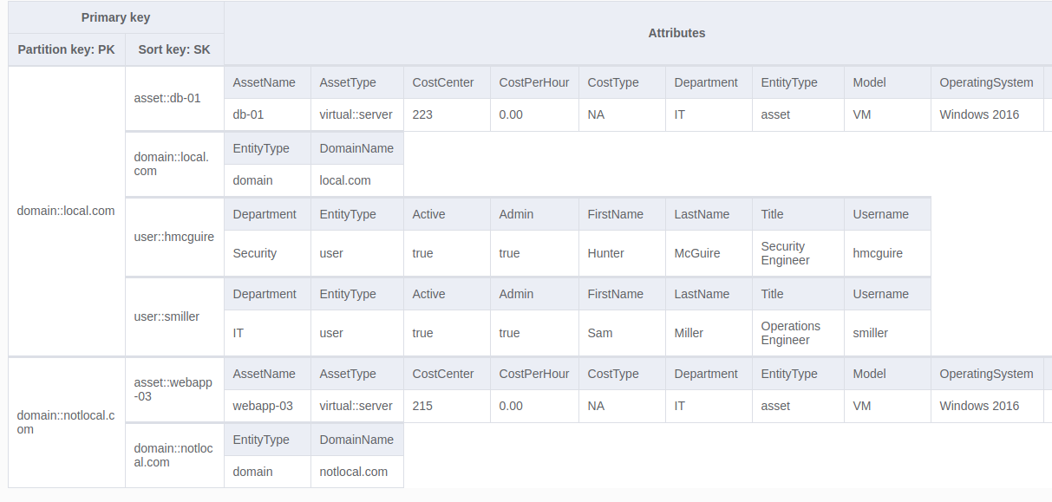
Single-table access pattern

Slide 9
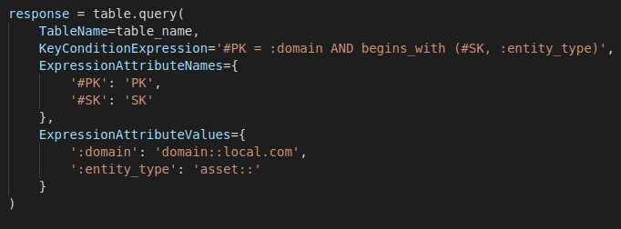
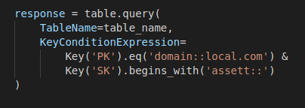
boto3 SDK helpers
(Without helper class)
(With Key helper Class)

Slide 10
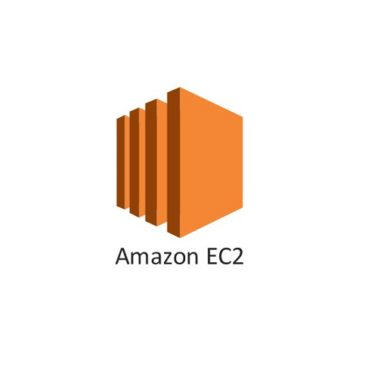

Demo App Overview
Data Model
Domain
Assets
Users
Tools
Docker
Flask App
Instance Profile(DynamoDB perms)
DynamoDB service
NoSQL Workbench
VSCode
Insomnia

